Slide 1
Comparative Study of Clustering Algorithms
Submitted by
Viha Gupta 2K14/CO/140
Kartik Bhutani 2K14/CO/147
Under the guidance and supervision of
Mr. Anil Singh Parihar

Slide 2
Project Organization
Implementation of 3 famous clustering algorithms
Deep analysis of their behavior on various criteria
Applied them on two and real world applications
Market Segmentation
Demonetization
Prepared an App. to provide an interface between these algorithms and a layman user

Slide 3
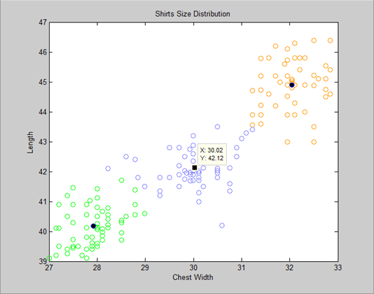
What is clustering
Segregation of objects based on similarity
Gives rise to various algorithms
Algos differ in their
similarity measure
Used to extract
information from
raw data
Helps find patterns

Slide 4
Types
Divided into 2 broad categories:
HARD CLUSTERING
Each object either belongs to a specific cluster or does not
Example: K-means
SOFT CLUSTERING
Each object belongs to a specific cluster to a certain degree
Example: Fuzzy K-means, Probabilistic C-means

Slide 5
Study of Clustering Algorithms
We study the following centroid-based algos:
K-means
Fuzzy K-means or Fuzzy C-means (FCM)
Probabilistic C-means (PCM)

Slide 6
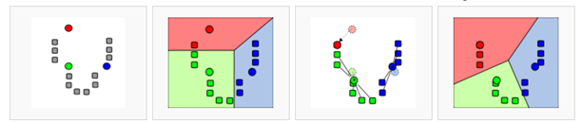
K-means
How the algorithm works
Partition of data into k distinct clusters
Object assigned to nearest cluster where distances from cluster are minimum
Fast
K must be specified
Result may depend on initial clusters

Slide 7
Fuzzy K-means (FCM)
How the algorithm works
Similar to K-means
Adds membership value to each point
Total membership of each point is unity
Advantages
Better than k-means
Disadvantages
K must be specified
Sensitive to noise

Slide 8
Probabilistic C-means
Why Probabilistic C-means?
Overcomes noise sensitivity of FCM
Consider a point equidistant from 2 centers
FCM assigns same membership despite distance from other points of cluster
Algo should consider this distance
Hence PCM
-Extension of FCM
-Considers typicality

Slide 9
Parameters of Measurement
We analyse the algos based on:
Number of iterations
Average Distance From Center
Running Time

Slide 10
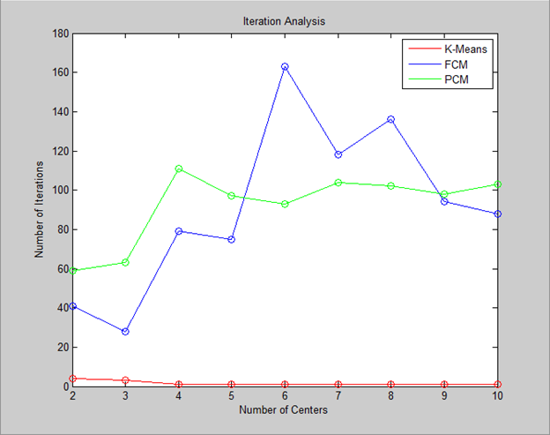
Number of Iterations
Number of iterations required to run a particular data set for different values of k, ranging from 2 to 9

Slide 11
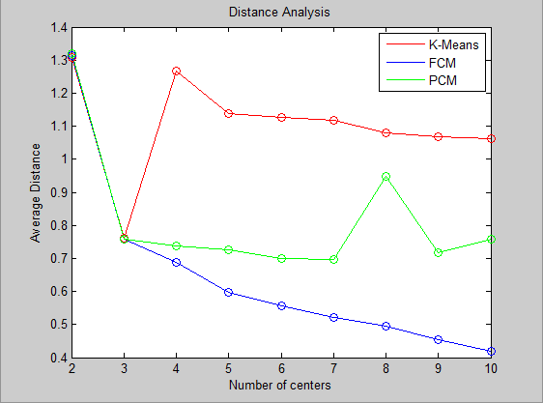
Average Distance
Average of distances between all data points and corresponding clusters. Used to gauge precision of centroids.

Slide 12
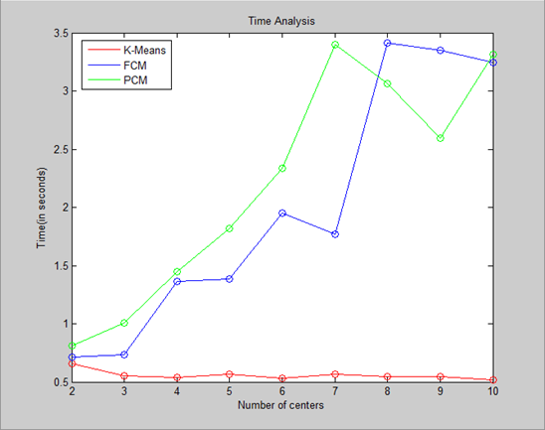
Running Time
Running time of a particular data set for different values of k, ranging from 2 to 9

Slide 13
Market Segmentation
Can be used my business to improve marketing strategies
Consider Shirt
sizes example:
-Company takes
survey
-People give chest
width & length
measuements
-Want to know
ideal sizes form
S, M, L

Slide 14
Demonetization
Application with 3D data set
Clustering can be used for one of the most recent issues being faced today- Demonetization
Understanding the Problem
Govt has 2.5 lakh limit
Many violating cases
Govt must prioritize localities to investigate
Places with more frequency of cases need more attention
Dynamic paradigm

Slide 15
Demonetization
Consider a 3-D data set consisting of
longitude
latitude
amount deposited
Data is divided into 3 parts
Below 2.5 lacs
Above 10 lacs
Between 2.5 and 10 lacs

Slide 16
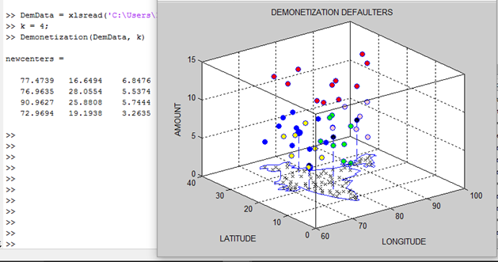
Raichur, Hyderabad
Gurugram, Haryana
Shillong, Meghalaya
Andheri East, Mumbai

Slide 17
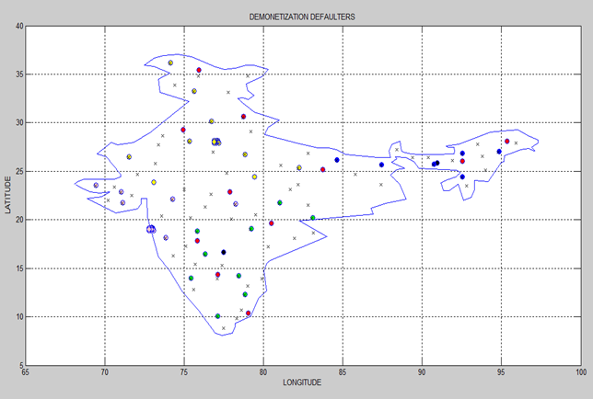

Slide 18
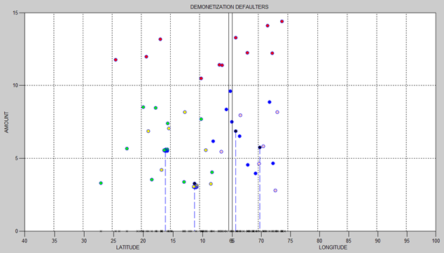

Slide 19
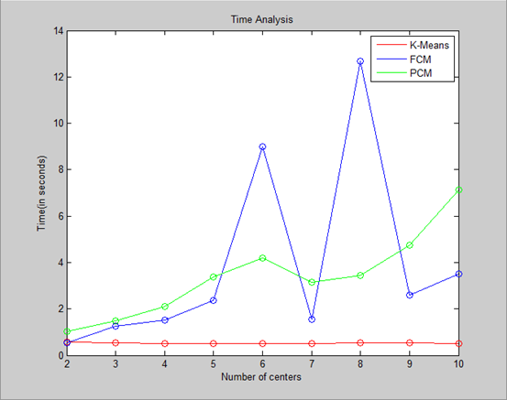
Problems Faced By Algos
Values of k must be known before hand
Layman user may not know the best algo to use
“Best” algo depends on data set
Data set 1
Data set 2

Slide 20
Ideal Centers
We develop an algo that will
determine ideal number of k
determine ideal algo for the data
perform the specific algo
User inputs following
data
range of k
criteria
-lowest running time
-highest priority
-mixed

Slide 21
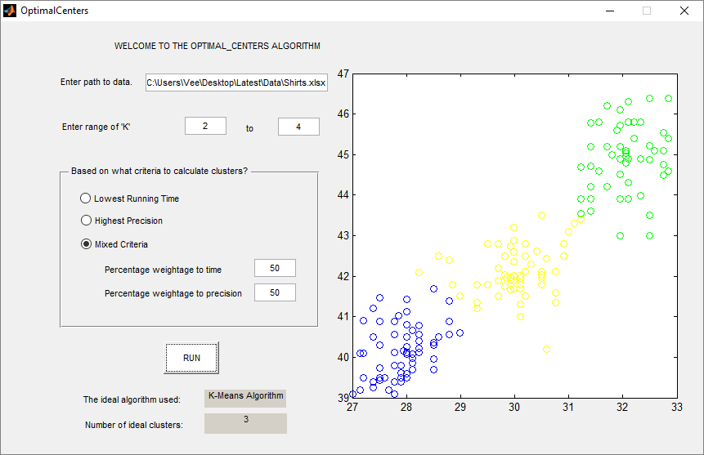

Slide 22
More Applications
Search engines- group similar objects in one cluster and dissimilar objects far from each other
Opening branches/expanding business- eg pizza hut
Organizing data in hadoop applications- categorizing unorganized big data from social networking sites
Earthquake studies- observing earthquake epicenters to identify dangerous zones
Biological studies-classification of species based on features

Slide 23
Thank You

